Slide 1
Stream Classes
Chapter 19

Slide 2
Contents
Java I/O classes and Interfaces
File Handling
Stream Classes: Byte Stream and Character Stream

Slide 3
Introduction
Java I/O is designed based on 4 abstract classes:
InputStream
OutputStream
Reader
Writer
Use Character stream – while working with string/ chars; Byte Stream – other binary objects
For Byte Stream
For Character Stream

Slide 4
1. Byte Stream
The following are some ByteStreams:
InputStream
OutputStream
FileInputStream
FileOutputStream
ByteArrayInputStream
ByteArrayOutputStream
FilterInputStream
FilterOutputStream
BufferedInputStream
BufferedOutputStream
PushbackInputStream
PushbackOutputStream
SequenceInputStream
PrintStream
DataInputStream
DataOutputStream

Slide 5
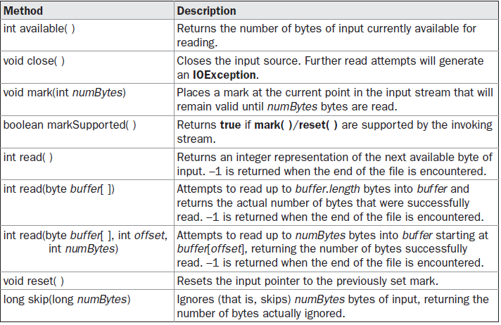
a) InputStream

Slide 6
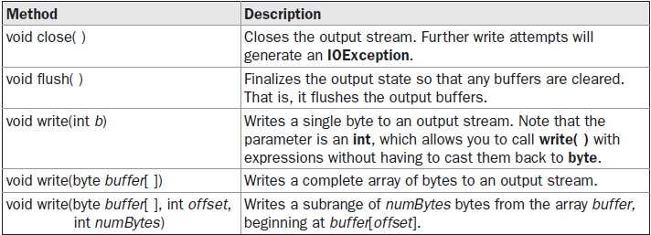
b) OutputStream

Slide 7
c) FileInputStream
Used to create InputStream to read bytes from a file
2 Constructors:
FileInputStream(String filepath)
FileInputStream(File fileObj)
Java Program
FileInputStream fin = new FileInputStream()
FileOutputStream fout = new FileOutputStream()
E:/aa/xx.txt
fin
fout
Throws FileNotFoundException

Slide 8
When a file is opened in Input mode, it is ready for reading
Common methods:
available()
skip(int length)
read() – Reads a bytestream – hence to be converted as char/string

Slide 9
d) FileOutputStream
Used to write bytes to file
Constructors:
FileOutputStream(String filePath)
FileOutputStream(File fileObj)
FileOutputStream(String filePath, boolean append)
FileOutputStream(File fileObj, boolean append)
If “append” is true - the file is opened in append mode
If NO file exists, it is created in this mode!!!

Slide 10
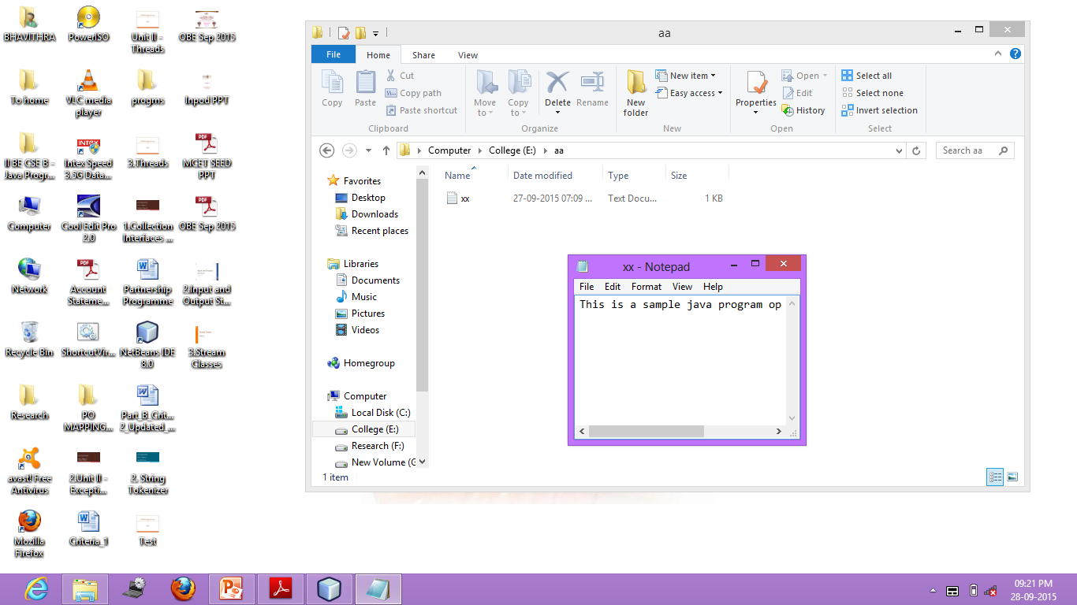

Slide 11
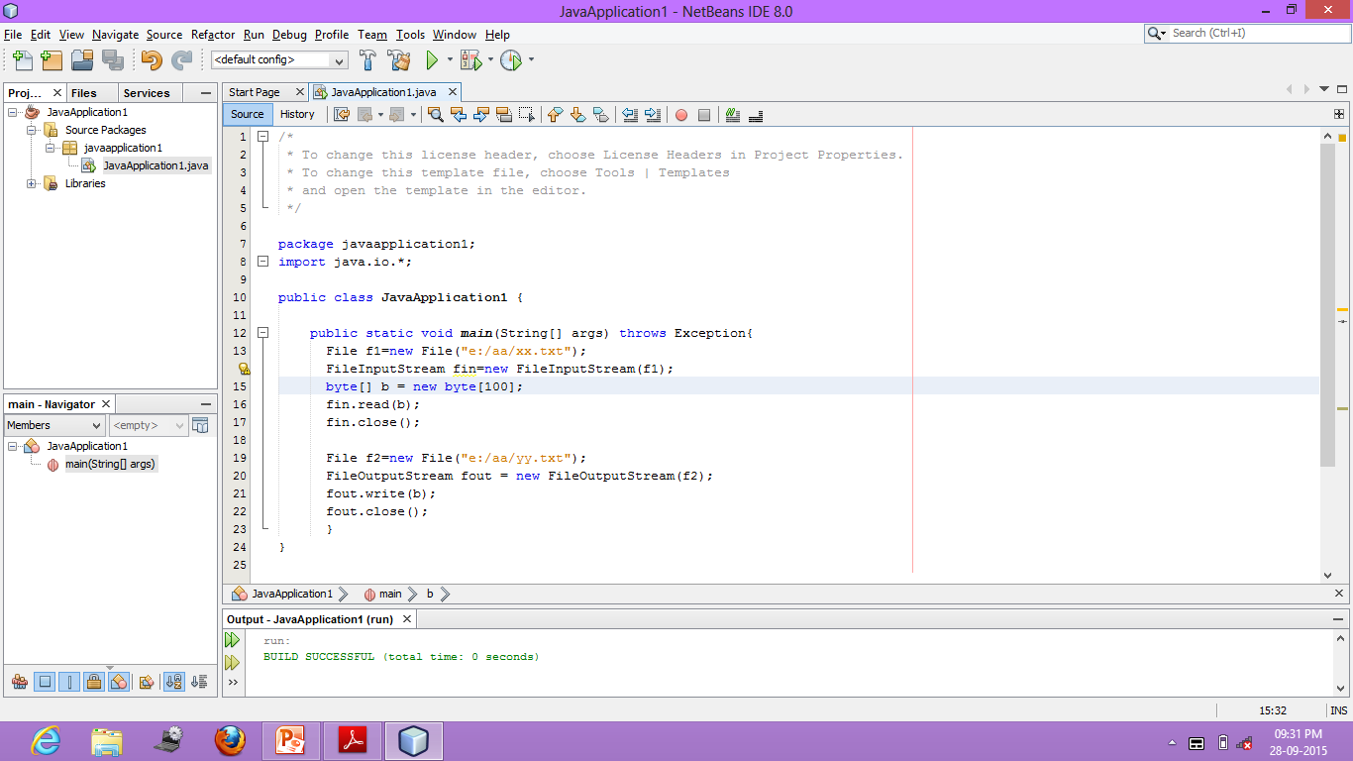

Slide 12
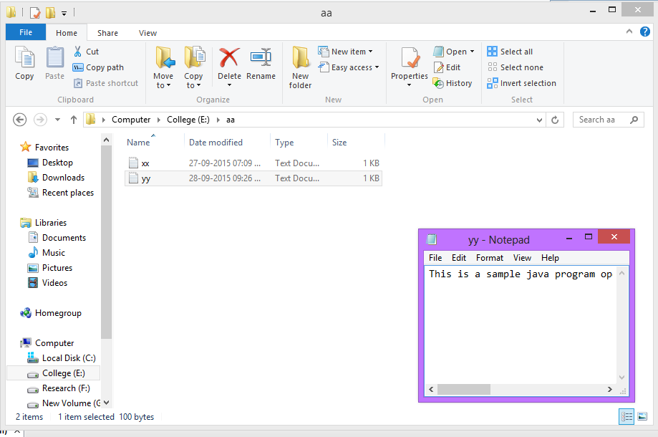

Slide 13
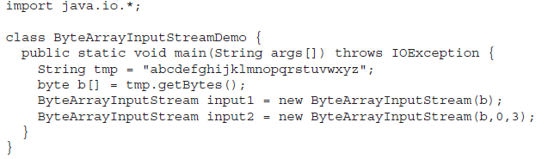
e) ByteArrayInputStream
It is an implementation of an input stream that uses a byte array as the source
Constructors
ByteArrayInputStream(byte array[ ])
ByteArrayInputStream(byte array[ ], int start, int numBytes)

Slide 14
f) ByteArrayOutputStream
This is an implementation of an output stream that uses a byte array as the destination
Constructors:
ByteArrayOutputStream( ) → default size = 32 bytes
ByteArrayOutputStream(int numBytes)

Slide 15
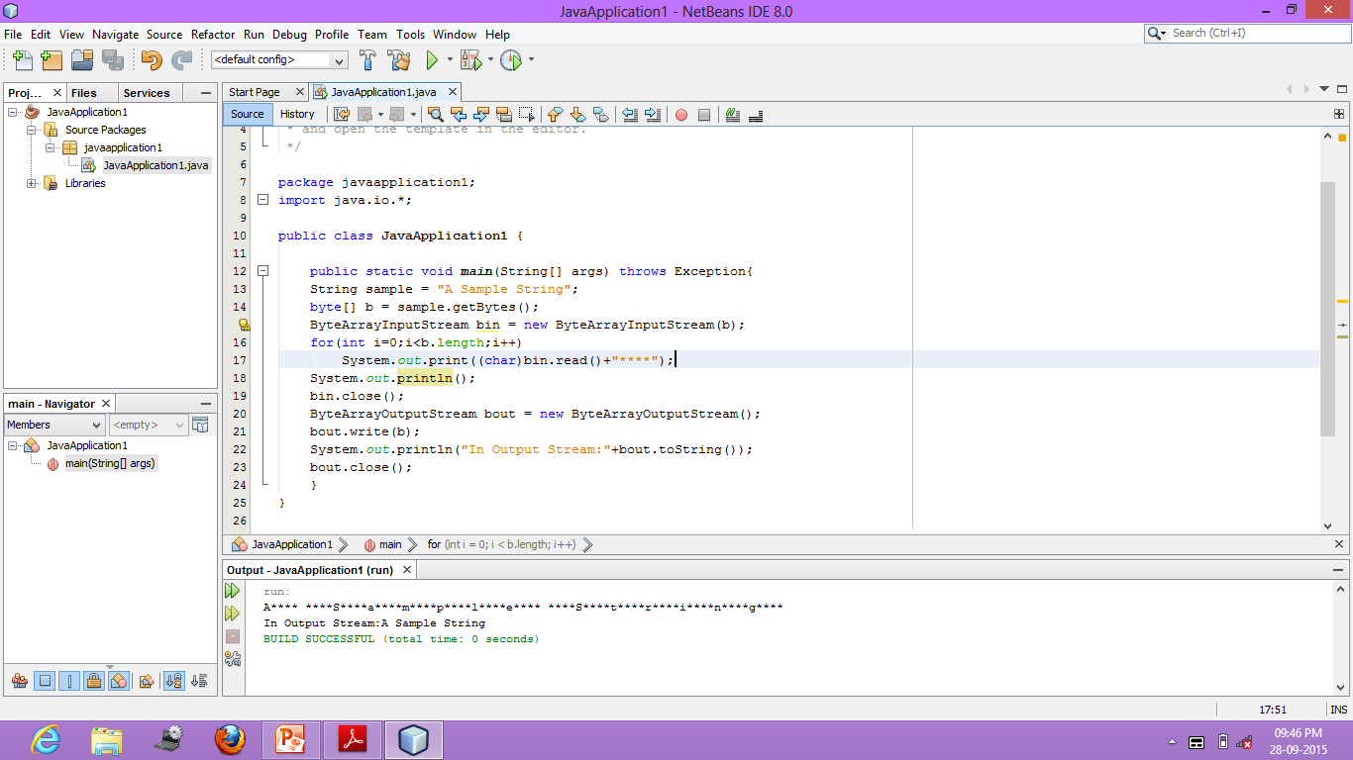

Slide 16
g) FilterInputStream and h) FilterOutputStream
Extensions of generic input and output streams
Typical extensions are buffering, character translation, and raw data translation
Constructors:
FilterOutputStream(OutputStream os)
FilterInputStream(InputStream is)

Slide 17
Buffered Byte Streams
This buffer allows Java to do I/O operations on more than a byte at a time, hence increasing performance
Contains
BufferedInputStream
BufferedOutputStream
PushbackInputStream

Slide 18
BufferedInputStream
2 Constructors:
BufferedInputStream(InputStream inputStream)
BufferedInputStream(InputStream inputStream, int bufSize)
Advantages of using BufferedInputStream:
Provides significant positive impact on performance
It provides the foundation required to support moving backward in the stream of the available buffer
It supports the following methods:
mark(int position) and
reset( )

Slide 19
BufferedOutputStream
Similar to any OutputStream with the exception of an added flush( ) method
Used to ensure that data buffers are physically written to the actual output device.
Need to call flush( ) to cause any data that is in the buffer to be immediately written
2 Constructors:
BufferedOutputStream(OutputStream outputStream)
BufferedOutputStream(OutputStream outputStream, int bufSize)

Slide 20
PushbackInputStream
Pushback is used on an input stream to allow a byte to be read and then returned (pushed back) to the stream
Supports 3 other functions:
void unread(int ch)
void unread(byte buffer[ ])
void unread(byte buffer, int offset, int numChars)

Slide 21
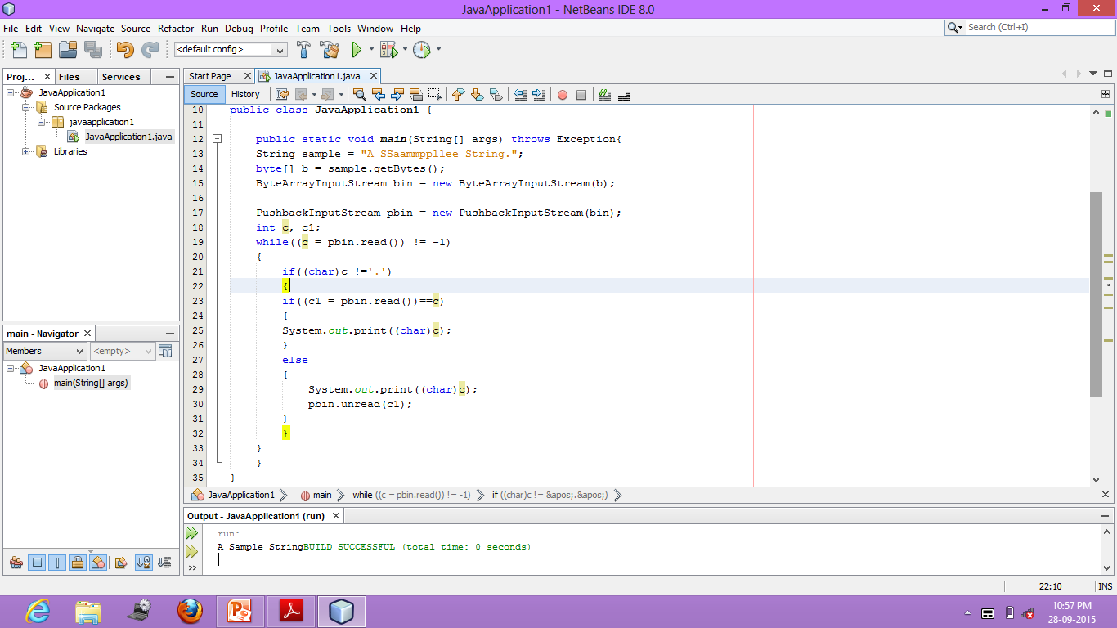

Slide 22
m) Sequence Input Stream
The SequenceInputStream class allows you to concatenate multiple InputStreams
Constructors:
SequenceInputStream(InputStream first, InputStream second)
SequenceInputStream(Enumeration <? extends InputStream> streamEnum)
The class fulfills read requests from the first InputStream until it runs out and then switches over to the second one.

Slide 23
n) PrintStream
The PrintStream class provides all of the output capabilities we have been using from the System file handle, System.out
Constructors:
PrintStream(OutputStream outputStream)
PrintStream(OutputStream outputStream, boolean flushOnNewline)
PrintStream(OutputStream outputStream, boolean flushOnNewline, String charSet)
charSet → character encoding

Slide 24
Other Constructors:
PrintStream(File outputFile)
PrintStream(File outputFile, String charSet)
PrintStream(String outputFile)
PrintStream(String outputFile, String charSet)
printf( ) method is added to the PrintStream class

Slide 25
O) DataInputStream
DataInputStream and DataOutputStream enable to write or read primitive data to or from a stream.
DataInputStream extends FilterInputStream, which extends InputStream
Constructor:
DataInputStream(InputStream inputStream)
Methods:
double readDouble( )
boolean readBoolean( )
int readInt( )

Slide 26
p) DataOutputStream
DataOutputStream extends FilterOutputStream, which extends OutputStream
Constructors
DataOutputStream(OutputStream outputStream)
3 Methods:
final void writeDouble(double value)
final void writeBoolean(boolean value)
final void writeInt(int value)

Slide 27
Random Access File
The file pointer position can be changed randomly
RandomAccessFile(File fileObj, String access)
RandomAccessFile(String file, String access)
Access:
“r” → then the file can be read, but not written
“rw” → file is opened in read-write mode
“rwd” → the file is opened for read-write operations and every change to the file’s data will be immediately written to the physical device
“rws” → same as above, but metadata changes is also written to physical device immediatly

Slide 28
Random Access File: Methods
void seek(long newPos) – change the position of file pointer. Given as byte number
void setLength(long len) – sets the length of the file.

Slide 29
2. Character Stream
Reader
Writer
FileReader
FileWriter
CharArrayReader
CharArrayWriter
BufferedReader
BufferedWriter
PushbackReader
PrintWriter
Byte stream cannot handle “Unicode” characters.
This can be handled by Char stream

Slide 30
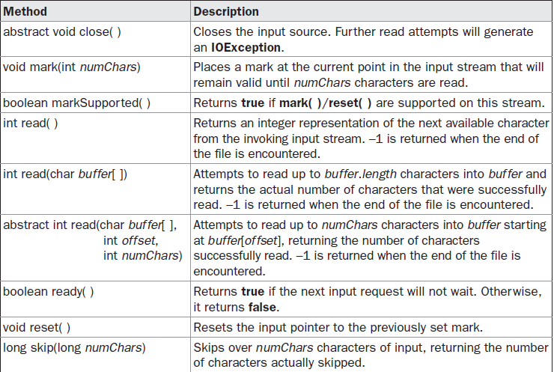
a) Reader

Slide 31
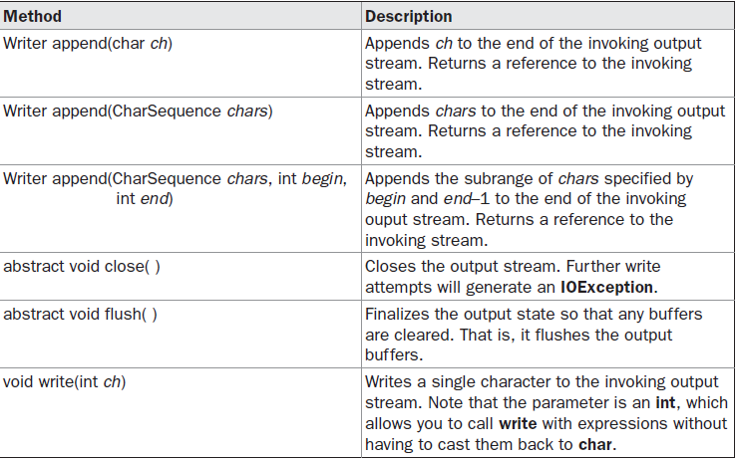
b) Writer

Slide 32
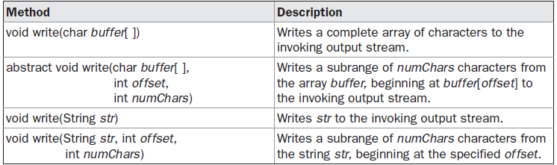
b) Writer…

Slide 33
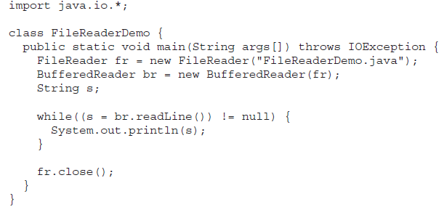
c) FileReader
FileReader(String filePath)
FileReader(File fileObj)

Slide 34

d) FileWriter
FileWriter(String filePath)
FileWriter(String filePath, boolean append)
FileWriter(File fileObj)
FileWriter(File fileObj, boolean append)

Slide 35

e) CharArrayReader
CharArrayReader is an implementation of an input stream that uses a character array as the source.
Constructors:
CharArrayReader(char array[ ])
CharArrayReader(char array[ ], int start, int numChars)

Slide 36
f) CharArrayWriter
CharArrayWriter is an implementation of an output stream that uses an array as the destination
Constructors
CharArrayWriter( )
CharArrayWriter(int numChars)

Slide 37

g) BufferedReader
BufferedReader improves performance by buffering input.
2 constructors:
BufferedReader(Reader inputStream)
BufferedReader(Reader inputStream, int bufSize)

Slide 38
h) BufferedWriter
A BufferedWriter is a Writer that buffers ouput.
Using a BufferedWriter can increase performance by reducing the number of times data is actually physically written to the output stream.
Two constructors:
BufferedWriter(Writer outputStream)
BufferedWriter(Writer outputStream, int bufSize)

Slide 39
i) PushbackReader
The PushbackReader class allows one or more characters to be returned to the input stream.
Two constructors:
PushbackReader(Reader inputStream)
PushbackReader(Reader inputStream, int bufSize)
3 other methods:
void unread(int ch)
void unread(char buffer[ ])
void unread(char buffer[ ], int offset, int numChars)

Slide 40
j) PrintWriter
PrintWriter is essentially a character-oriented version of PrintStream.
Constructors:
PrintWriter(Writer outputStream)
PrintWriter(Writer outputStream, boolean flushOnNewline)

